Slide 1
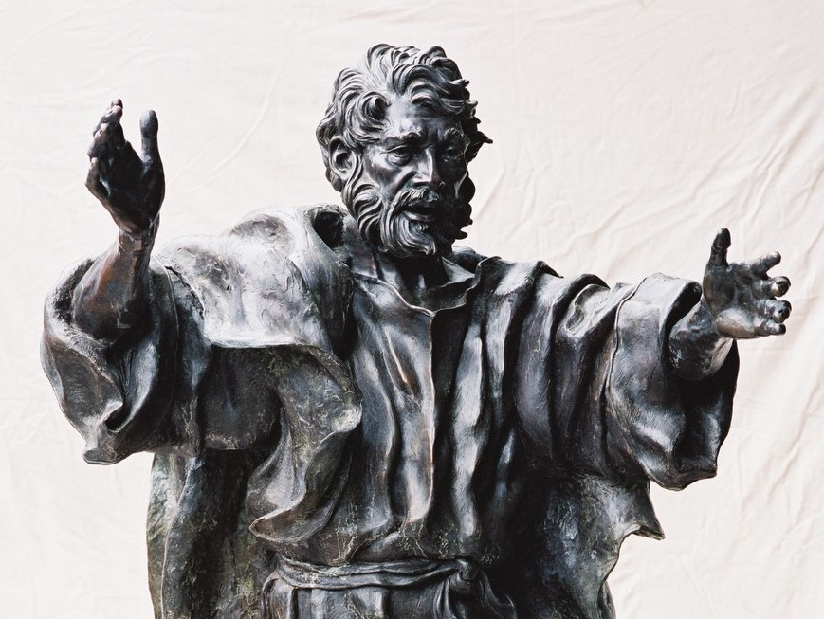
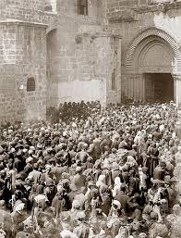
Peter preaches Resurrection
Part One:
The Spirit was promised to ALL people and the promise was now being fulfilled
This was a world-changing moment
This was part of a saving work of God that would be available to all

Slide 2
Peter preaches Resurrection
People of Israel, listen! God publicly endorsed Jesus of Nazareth by doing wonderful miracles, wonders and signs through Him, as you well know! But you followed God’s prearranged plan. With the help of lawless Gentiles, you nailed Him to the cross and murdered Him. However, God released Him from the horrors of death and raised Him back to life again, for death could not keep Him in its grip. (2:22-24)

Slide 3
Peter preaches Resurrection
The audience knew that God had ‘endorsed’ Jesus through miraculous signs
All that happened was part of God’s plan
The listeners are responsible for Jesus’ death
BUT:
God released Him from death
And raised Him back to life
Death could not keep Jesus

Slide 4
Peter preaches Resurrection
King David said this about Him: “I know the Lord is always with me. I will not be shaken, for He is right beside me. No wonder my heart is filled with joy, and my mouth shouts His praises! My body rests in hope. For You will not leave my soul among the dead or allow Your Holy One to rot in the grave. You have shown me the way of life and You will give me wonderful joy in Your presence.”
(2:25-28, based on Psalm 16:8-11)

Slide 5
Peter preaches Resurrection
Dear brothers, think about this! David wasn’t referring to himself when he spoke these words I have quoted, for he died and was buried and his tomb is still here among us. But he was a prophet and he knew God had promised with an oath that one of David’s own descendants would sit on David’s throne as the Messiah. David was looking into the future and predicting the Messiah’s resurrec-tion. He was saying that the Messiah would not be left among the dead and that his body would not rot in the grave. This prophecy was speaking of Jesus, whom God raised from the dead, and we are witnesses of this. (2:29-32)

Slide 6
Peter preaches Resurrection
Now He sits on the throne of highest honor in heaven, at God’s right hand. And the Father, as He had promised, gave Him the Holy Spirit to pour out upon us, just as you see and hear today. For David himself never ascended into heaven, yet he said, “The Lord said to my Lord: sit in honor at my right hand until I humble your enemies, making them a footstool under your feet.”
So, let it be clearly known by everyone in Israel that God has made this Jesus whom you crucified to be both Lord and Messiah! (2:33-35)

Slide 7
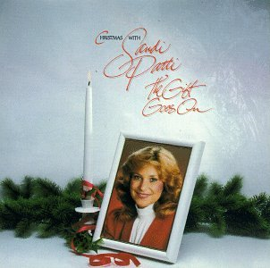
Peter preaches Resurrection
Jesus has been elevated to the highest place, at the right hand of the Father
The Father gave the Spirit to Jesus so He could pour it out on us
There is a day coming when those who oppose Jesus will be humbled
The resurrection proves that Jesus is Messiah

Slide 8
Peter preaches Resurrection
Peter’s words convicted them deeply, and they said to him and to the other apostles, “Brothers, what should we do?”
Peter replied, “Each of you must turn from your sins and turn to God, and be baptized in the name of Jesus Messiah for the forgiveness of your sins. Then you will receive the gift of the Holy Spirit. This promise is to you and to your children, and even to the Gentiles – all who have been called by the Lord our God.” Then Peter continued preaching for a long time, strongly urging all his listeners, “Save yourselves from this generation that has gone astray!” (2:37-40)

Slide 9
Peter preaches Resurrection
The people experienced conviction
The right response to conviction is change
Peter called people to be baptized in the name of Jesus Messiah
God’s promise is forgiveness and the gift of the Holy Spirit
God’s offer is open to everyone!

Slide 10
Peter preaches Resurrection
How do we share our faith?
Begin by recognizing that human nature hasn’t changed – we still want to do what we want to do!
Pray for and wait for the Holy Spirit to bring conviction to people’s hearts
Those who sense the need to change may be open to the call to follow Jesus
We can assure people of God’s forgiveness and the promise of His Presence
This good news is for everyone, so we don’t need to figure out who is eligible

